Slide 1

Alternate Disk Install
Rob Nava – AIX CTS
Notes:
‹#›

Slide 2
Description
The alt_disk_install command clones either the currently running system or a mksysb image to an alternate disk. This command is obsolete in AIX 5.3 and later. It is replaced by three separate commands. The traditional alt_disk_install command still works, but no new features or functions will be supported by the old command. The new commands –
alt_disk_copy - Clones (makes a copy of) the currently running system to an alternate disk.
alt_disk_mksysb - Installs an alternate disk with a mksysb install image
alt_rootvg_op - Performs operations on existing alternate rootvg volume groups
‹#›

Slide 3

Description, cont.
The alt_disk commands can be used to backup the operating system to an alternate disk and allow administrators a way to update the operating system to the next release, technology level, or service pack, without taking the machine down for an extended period of time.
This can be done in two ways: by installing a mksysb image on a separate disk, or by cloning the current system and then applying updates to get to the next technology level or service pack.
‹#›

Slide 4

How it works
Required filesets:
bos.alt_disk_install.rte ==> for cloning existing rootvg to an alternate disk
bos.alt_disk_install.boot_images ==> for restoring a mksysb to an alternate disk
The alt_disk commands create a new Volume Group (VG) called altinst_rootvg. It then creates all the corresponding LVs and FSs in altinst_rootvg based on the rootvg image to be copied. In this case each LV with have the 'alt_' prefix and each filesystem with have '/alt_inst' in front of the regular mount point. This is so both sets of filesystems can be active at once during the copying of the rootvg image and any subsequent customization such as an update_all etc.
‹#›

Slide 5
The Three Phases of alt_disk_install
Phase 1
Creates the altinst_rootvg volume group, the alt_ "logical volumes", the /alt_inst file systems, and restores the mksysb or rootvg data.
Phase 2
Runs any specified customization script, installs updates, new filesets, fixes or bundles (cloning only), copies a resolv.conf file if specified, and copies files over to remain a NIM client if specified.
Phase 3
Unmounts the /alt_inst file systems, renames the file systems and logical volumes, removes the alt_ logical volumes names from the ODM and varies off the altinst_rootvg. It sets the bootlist and reboots if specified.
Each phase can be run separately, Phases 1 and 2 can be run together, or run Phases 2 and 3 together. Phase 2 can be run multiple times before Phase 3 is run.
‹#›

Slide 6
You must run Phase 3 to get a volume group that is a usable rootvg. Running Phase 1 and 2 leave the /alt_inst file systems mounted.
Once you have completed all three phases, you will see that you have rootvg, and altinst_rootvg. To use the new rootvg volume group, you will reboot from the new disk. At this point the alternate disk will be rootvg, and the original disk will be old_rootvg.
Here is what the lspv output will look like -
# lspv
hdisk0 00cfb0fd1edf92be rootvg active
hdisk1 00cfb0fd207b338f altinst_rootvg active
While the altinst_rootvg volume group is active (during phase 1 and 2) it will look as follows –
# lsvg -l altinst_rootvg
altinst_rootvg:
LV NAME TYPE LPs PPs PVs LV STATE MOUNT POINT
alt_hd5 boot 1 1 1 closed/syncd N/A
alt_hd6 paging 8 8 1 closed/syncd N/A
alt_hd8 jfs2log 1 1 1 open/syncd N/A
alt_hd4 jfs2 3 3 1 open/syncd /alt_inst
alt_hd2 jfs2 24 24 1 open/syncd /alt_inst/usr
alt_hd9var jfs2 1 1 1 open/syncd /alt_inst/var
alt_hd3 jfs2 2 2 1 open/syncd /alt_inst/tmp
alt_hd1 jfs2 1 1 1 open/syncd /alt_inst/home
alt_hd10opt jfs2 2 2 1 open/syncd /alt_inst/opt
alt_hd11admin jfs2 2 2 1 open/syncd /alt_inst/admin
‹#›

Slide 7


At the completion of phase 3 of the alt_disk commands, the altinst_rootvg name will show with lspv as a place holder, but the volume group will not be varied on. If you query the volume group, you will see that the names of the LVs have had the alt_ prefix removed, and are back to the standard rootvg LV names. At this point, you can have your bootlist set to the new disk and reboot, and you will be up on the copy of rootvg.
# lspv
hdisk0 00cfb0fd1edf92be rootvg active
hdisk1 00cfb0fd207b338f altinst_rootvg
# lsvg -l altinst_rootvg
0516-010 : Volume group must be varied on; use varyonvg command.
‹#›

Slide 8

# lqueryvg -Atp hdisk1
Max LVs: 256
PP Size: 26
Free PPs: 497
LV count: 10
PV count: 1
Total VGDAs: 2
Conc Allowed: 0
MAX PPs per PV 1016
MAX PVs: 32
Quorum (disk): 1
Quorum (dd): 1
Auto Varyon ?: 0
Conc Autovaryo 0
Varied on Conc 0
Logical: 00cfb0fd00004c000000011edc512423.1 hd5 1
00cfb0fd00004c000000011edc512423.2 hd6 1
00cfb0fd00004c000000011edc512423.3 hd8 1
00cfb0fd00004c000000011edc512423.4 hd4 1
00cfb0fd00004c000000011edc512423.5 hd2 1
00cfb0fd00004c000000011edc512423.6 hd9var 1
00cfb0fd00004c000000011edc512423.7 hd3 1
00cfb0fd00004c000000011edc512423.8 hd1 1
00cfb0fd00004c000000011edc512423.9 hd10opt 1
00cfb0fd00004c000000011edc512423.10 hd11admin1
Physical: 00cfb0fd207b338f 2 0
Total PPs: 542
LTG size: 128
HOT SPARE: 0
AUTO SYNC: 0
VG PERMISSION: 0
SNAPSHOT VG: 0
IS_PRIMARY VG: 0
PSNFSTPP: 4352
VARYON MODE: ???????
VG Type: 0
Max PPs: 32512
Note: DO NOT use commands like importvg, varyonvg, exportvg, etc against an altinst_rootvg.
This is because the LV names conflict with the LVs on the running system.
As these commands are not alt_disk aware, you can corrupt the information on your altinst_rootvg, and possibly even corrupt the /etc/filesystems of the running system.
Only use alt_disk commands to manipulate an alternate volume group.
You can do all of the following using alt_rootvg_op:
Wakeup (varyon), Sleep (varyoff), Rename (chvg), and Cleanup (export).
(We will go over examples and flags in the next section.)
‹#›

Slide 9
Hint #1 - If cloning the existing rootvg to an alternate disk and doing an update_all:
While a system can be updated to a new Technology Level or Service Pack using alt_disk_install, it cannot be migrated to a new version. To do that, the nimadm command must be used.
Prior to the alt_disk_copy with an update_all, bos.rte.install and bos.alt_disk_install.rte must be updated on the existing system:
They do not have any requisites, nor do they require a reboot.
They can be installed in the applied state, then reject them back to the previous version after the operation, if desired.
These two filesets deliver the updated version of the alt_disk_copy command as well as the installp command. While updating these filesets to the new version is not enforced by the alt_disk process, it is highly recommended and will result in a much higher success rate. The filesets should be updated to the level currently in the software source that you will be using to do the update_all.
‹#›

Slide 10
Hint #2 – If a mksysb is being copied to an alternate disk:
Mksysb images that are the same or higher version than the existing rootvg can be cloned. Lower versions cannot be cloned.
The level of the alt_disk install software must match the level of the mksysb you are restoring.
ex. Existing rootvg is 5300-06. Mksysb is 6100-02. The alt_disk_install filesets should be:
bos.alt_disk_install.rte 6.1.2.x
bos.alt_disk_install.boot_image 6.1.2.x
The mksysb image that is used must be created ahead of time and have all the necessary device and kernel support required for the system it will be installed on. No new device or kernel support can be installed before the system is rebooted from the newly installed disk.
‹#›

Slide 11
How to use it
Alt_disk operations can be run locally on the system (from smitty or the command line)
They can also be executed from a NIM master. You may wish to do this if the master houses an lpp_source you wish to use to update, or a mksysb image you want to install to an alternate disk.
The NIM master executes the equivalent of the alt_disk_copy or the alt_disk_mksysb commands. Separate operations against the alternate disk, using alt_rootvg_op, will have to be done from command line on the system itself.
A NIM master is also capable of migrating a system to another version or release of AIX using the 'nimadm' command (NIM Alternate Disk Migration). This uses a different process, that is not covered in this discussion.
‹#›

Slide 12
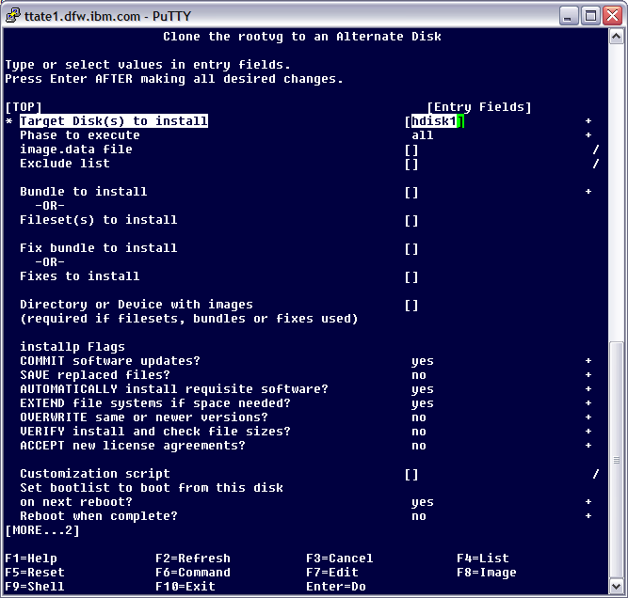

Local examples of alt_disk creation
1. To perform a clone of the existing rootvg to hdisk1
smitty
# smitty alt_clone
Or command line:
# alt_disk_copy -d hdisk1
‹#›

Slide 13
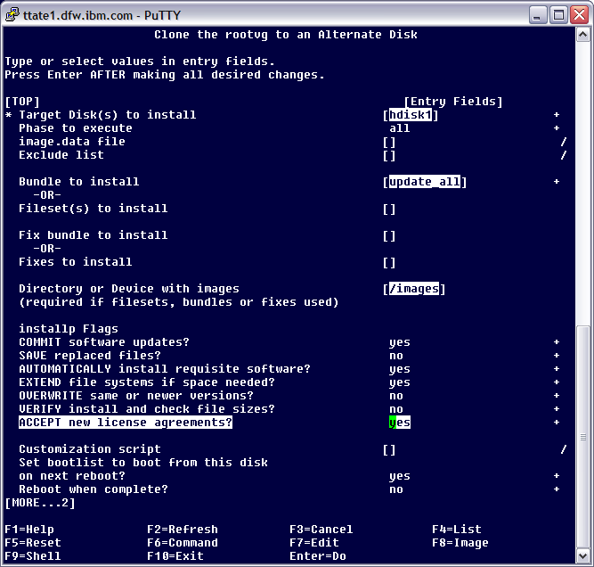

2. To perform a clone of the existing rootvg to hdisk1, and during the process update it to a new TL in /images
# cd /images
# installp -ad . bos.rte.install bos.alt_disk_install.rte
smitty
# smitty alt_clone
command line
# alt_disk_copy -d hdisk1 -b update_all -l /images
The bootlist would then be set to boot from hdisk1 on the next reboot.
‹#›

Slide 14

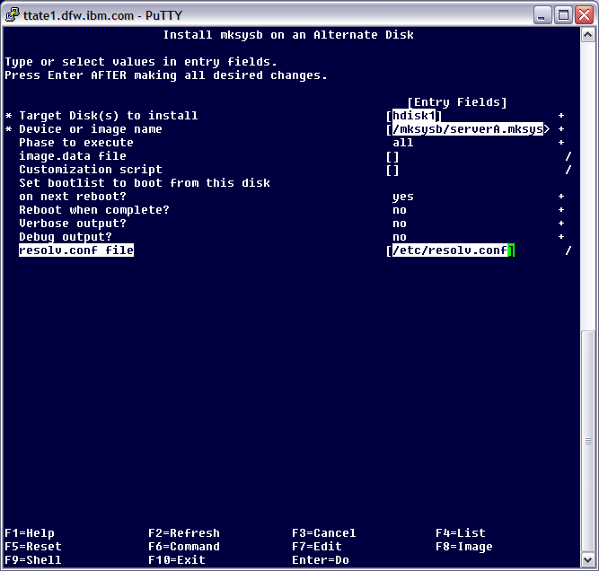
3. On an AIX 5.3 server. To clone a 6100-02 mksysb file called /mksysb/serverA.mksysb to hdisk1, copying over the current systems resolv.conf file, then rebooting when complete.
smitty
# smitty alt_mksysb
First locate and install the alt_disk_install software at the same version as in the mksysb:
bos.alt_disk_install.rte 6.1.2.0
bos.alt_disk_install.boot_images 6.1.2.0
command line
# alt_disk_mksysb -d hdisk1 -m /mksysb/serverA.mksysb -R /etc/resolv.conf -r
‹#›

Slide 15

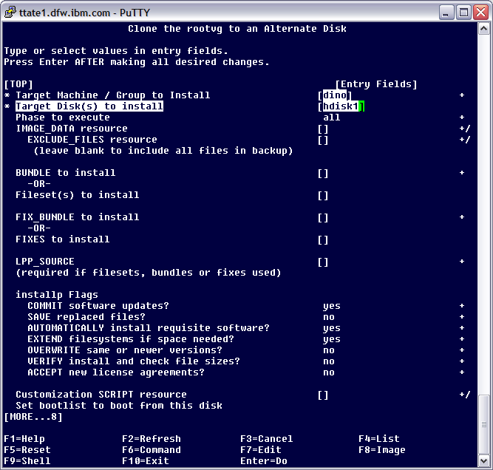
NIM initiated examples of altdisk creation
To perform a clone of the existing rootvg of dino to hdisk1
smitty
# smitty nim_alt_clone
Note: when doing an alt_disk operation from the NIM master, it exports and mounts the resources, remotely executes the commands, but does not show you the output of what it is doing, it just comes back to 'OK'.
To monitor the progress, or see if the operation worked, you must review the log files on the NIM client in /var/adm/ras. The primary one is nim.alt_disk_install but it may write to others, depending on what options you select.
command line
# nim -o alt_disk_install -a source=rootvg -a disk=hdisk1 dino
‹#›

Slide 16
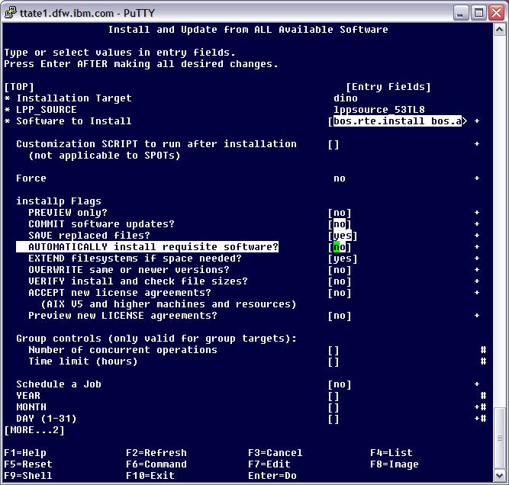
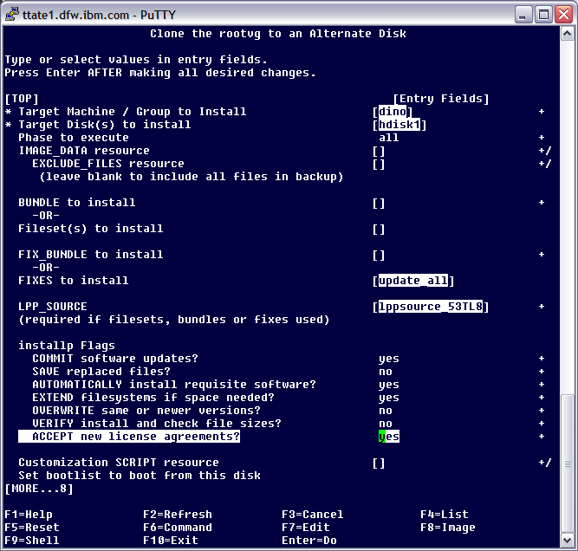
2. To perform a clone of the existing rootvg of dino to hdisk1, and during the process update it to a new TL from lppsource_53TL8. While first updating the installp and alt_disk utilities to the newer version in the applied state.
smitty
# smitty nim_inst_all
second,
# smitty nim_alt_clone
command line
First, update installp and alt_disk utilities to newer version in the applied state:
# nim -o cust -a filesets="bos.rte.install bos.alt_disk_install.rte" -a lpp_source=lppsource_53TL8 -a installp_flags=aXY dino
Second, kick off the alt disk install:
# nim -o alt_disk_install -a source=rootvg -a fixes=update_all -a lpp_source=lppsource_53TL8 -a installp_flags=acgNXY –a disk=hdisk1 dino
‹#›

Slide 17
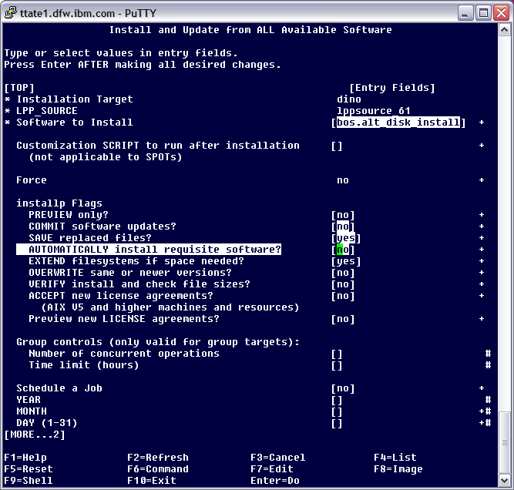
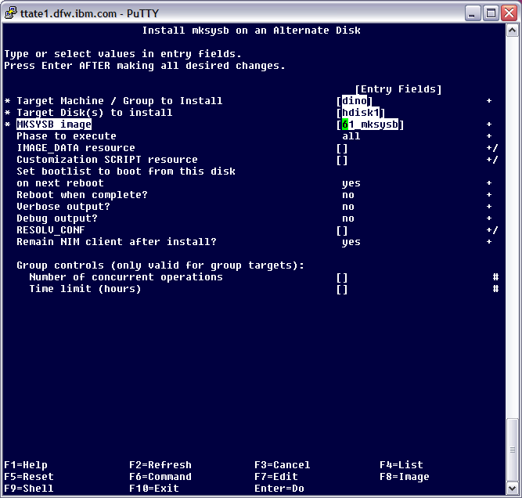
3. On an AIX 6100-02 NIM master, with lppsource_61 containing the base level bos.alt_disk_install* filesets with the updates to 6100-02, and a 6100-02 mksysb image, 61_mksysb, then perform a copy of that mksysb to hdisk1 on an AIX 5.3 client, dino.
smitty
# smitty nim_inst_all
# smitty nim_alt_mksysb
command line
# nim -o cust -a filesets=bos.alt_disk_install -a lpp_source=lppsource_61 -a installp_flags=aXY dino
# nim -o alt_disk_install -a source=mksysb -a mksysb=61_mksysb -a disk=hdisk1 dino
‹#›

Slide 18
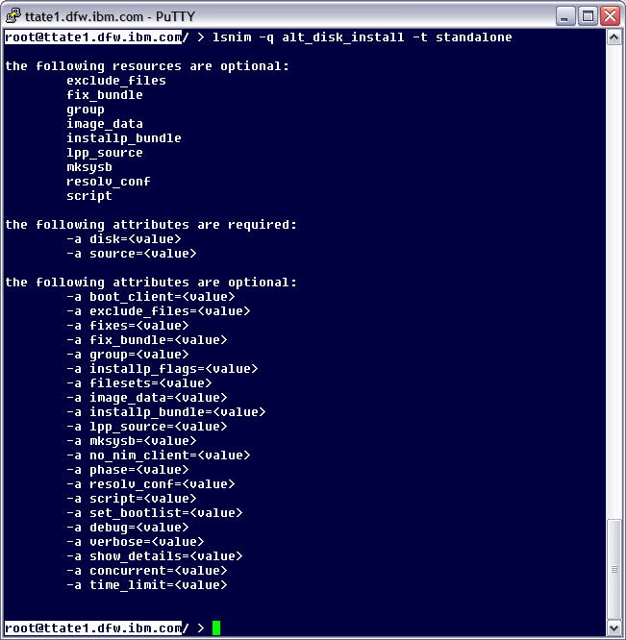
Other options under alt disk install
To see all the options, you can run the following on a NIM master
# lsnim -q alt_disk_install -t standalone
‹#›

Slide 19
Examples of manipulating the altdisk volume group. Local command line only:
1. Wake up altinst_rootvg on hdisk1, filesystems will be mounted with /alt_inst prefix. This basically what the system looks like after phase 1 of alt_disk_install.
# alt_rootvg_op -W -d hdisk1
2. Place the altinst_rootvg volume group back to sleep (unmounts filesystems, and changes lv names and odminfo)
# alt_rootvg_op -S
3. To rename the altinst_rootvg volume group to a different name, so another alt_disk operation can be run on a new disk.
# alt_rootvg_op -v 5308_rootvg -d hdisk1
4. To cleanup references to the altinst_rootvg volume group from the existing rootvg (does not remove data)
# alt_rootvg_op -X VGNAME ==> such as altinst_rootvg or old_rootvg
Note: Always put the volume group back to sleep after the wakeup. If multiple wakeups (without sleeping in between) are performed, or if the system is rebooted without putting the altinst_rootvg back to sleep, it can corrupt the image and make is unrecoverable.
‹#›

Slide 20

Questions?
‹#›

